Slide 1
Experiment no 1: Lab Work

Slide 2
Experiment 1: Version Control with Git
Objective: Understand and utilize Git for version control.
Tasks:
  Initialize a Git repository.
  Perform basic Git operations: add, commit, push, pull.
  Create and switch branches.
  Resolve merge conflicts.
  Collaborate using pull requests on GitHub.

Slide 3
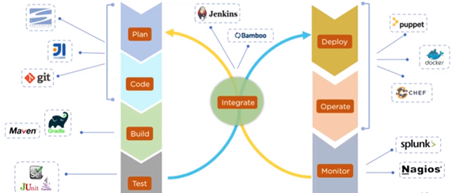
DevOps Tools needed

Slide 4
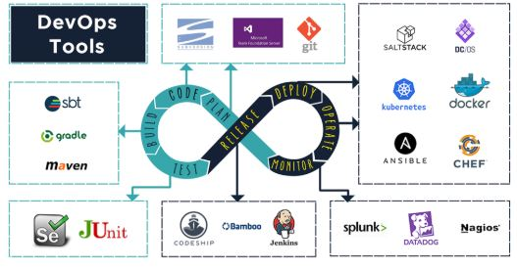

Slide 5
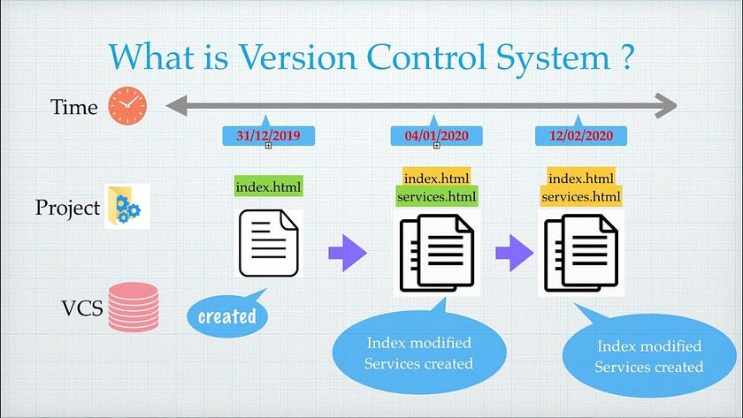
Version Control Systems

Slide 6
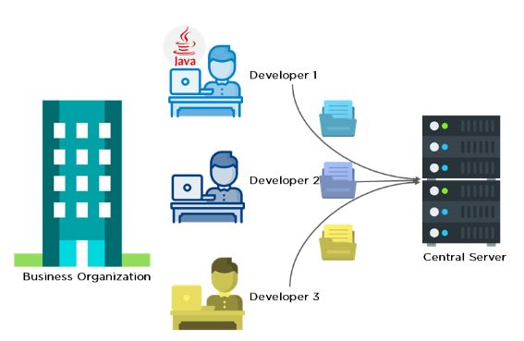
Before diving deep, let’s explain a scenario before Git:
Developers used to submit their codes to the central server without having copies of their own
Any changes made to the source code were unknown to the other developers
There was no communication between any of the developers

Slide 7
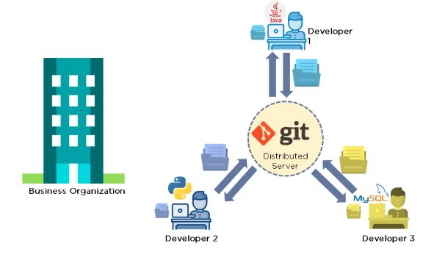
Now let’s look at the scenario after Git:
Every developer has an entire copy of the code on their local systems
Any changes made to the source code can be tracked by others
There is regular communication between the developers

Slide 8
What Is GitHub?
GitHub is a Git repository hosting service that provides a web-based graphical interface (GUI).
It helps every team member work together on a project from anywhere, making it easy to collaborate.

Slide 9
What is Git?
Git is a version control system used for tracking changes in computer files.
It is generally used for source code management in software development.
Git is used to tracking changes in the source code
The distributed version control tool is used for source code management
It allows multiple developers to work together
It supports non-linear development through its thousands of parallel branches

Slide 10
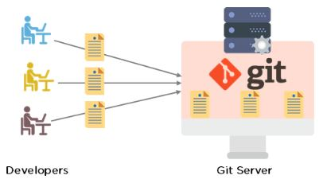
Features of Git
Tracks history
Free and open source
Supports non-linear development
Creates backups
Scalable
Supports collaboration
Branching is easier
Distributed development

Slide 11
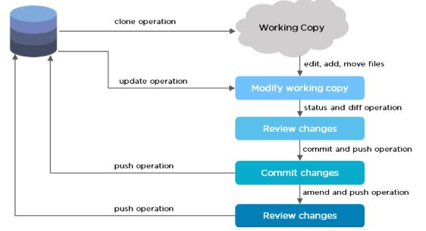
Git Workflow

Slide 12
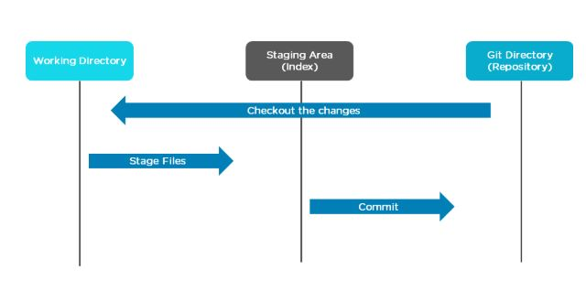
The Git workflow is divided into three states
Working directory - Modify files in your working directory
Staging area (Index) - Stage the files and add snapshots of them to your staging area
Git directory (Repository) - Perform a commit that stores the snapshots permanently to your Git directory. Checkout any existing version, make changes, stage them and commit.

Slide 13
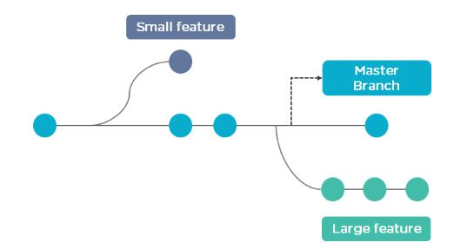
Branch in Git
Branch in Git is used to keep your changes until they are ready.
You can do your work on a branch while the main branch (master) remains stable.
After you are done with your work, you can merge it with the main office.

Slide 14
Branch in Git
The above diagram shows there is a master branch.
There are two separate branches called “small feature” and “large feature.”
Once you are finished working with the two separate branches, you can merge them and create a master branch.

Slide 15
Commands in Git
Create Repositories
git init
Make Changes
add
commit
status
Parallel Development
branch
merge
rebase
Sync Repositories
push
pull
add origin

Slide 16


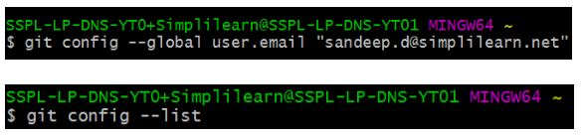
Check the version of Git.
Set up global config variables - If you are working with other developers, you need to know who is checking the code in and out, and to make the changes.

Slide 17
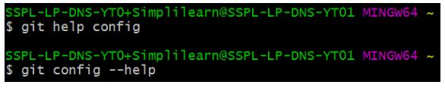
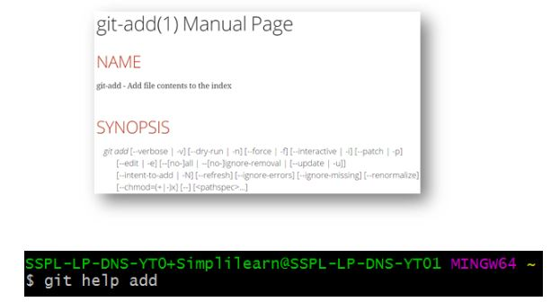
If in case you need help, use the following commands:
This will lead you to the Git help page on
the browser, which will display the following:

Slide 18



Create a “test” repository in the local system
Move to the test repository.
Create a new git instance for a project.

Slide 19
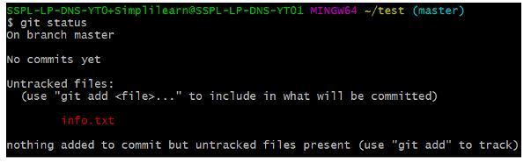
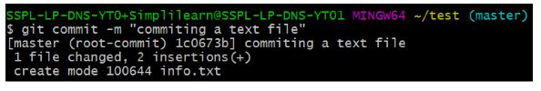
Create a text file called info.txt in the test folder; write something and save it.
Check the status of the repository.
Add the file you created to make a commit.
git add .
Commit those changes to the repository’s history with a short message.

Slide 20
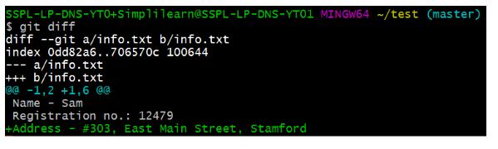
Make any necessary changes to the file and save.
Now that you’ve made changes to the file, you can compare the differences since your last commit.
Add GitHub username to Git Configuration.

Slide 21
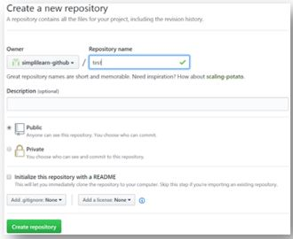
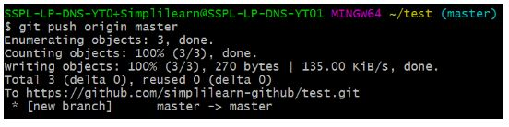
Create a remote repository.
Connect the local repository to your remote repository.
Push the file to the remote repository.

Slide 22

Refresh your repository page on GitHub. You will get your local file on your remote GitHub repository.
Create three more text files in the local repository - “info1.txt”, “info2.txt”, “info3.txt”.
Create a branch “first_branch” and merge it to the main (master) branch.
The below command switches to the new branch from the master branch.

Slide 23
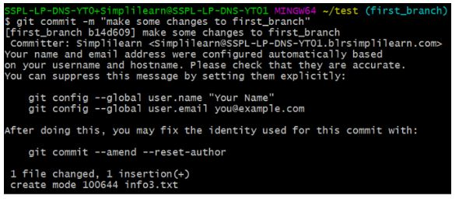
The below command creates and adds “info3.txt” to the first_branch.
Create a branch “first_branch” and merge it with the main (master) branch.

Slide 24

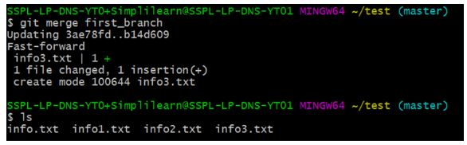
The below command shows that the new branch has access to all the files.
The below command shows that the master branch does not have an “info3.txt” file.
The command is used to merge “first_branch” with the master branch.
Now, the master branch has “info3.txt” file.

